Slide 1
SCHEDULE REMINDER DAEMON
​

Slide 2


TEAM
SCHEDULE REMINDER
ANKIT
SIDDHARTH
GYANDEEP
ADITYA
SAHIL
MENTOR- RAHUL SIR

Slide 3
Meet our team
Takuma Hayashi​
Mirjam Nilsson​
Flora Berggren​
President
Chief Executive Officer
Chief Operations Officer
VP Marketing

Slide 4
Introduction
The purpose of this project is to implement and checks for monthly and annual dates and sends/prints them on console every time the user logs in terminal. Once the obligation is met user can dismiss the reminders by calling the program with a command line to dismiss further notifications.

Slide 5
KEY OBJECTIVES
1 Add/Remove an obligation to a system configuration file.
2 Modify an obligation to a system configuration file.
3 compare the task reminder with current date
4 Obligation is met can dismiss the reminders

Slide 6
Environment Description:
Time Zone Support: IST- Kolkata
Language Support: US English
Deployment Considerations:
Easy setup: no session storage daemon, use tmpfs and memory caching to enhance performance.
Local storage is used.
No network latency to consider.
To scale buys a bigger CPU, more memory, larger hard drive, or additional hardware.

Slide 7
Integration Requirements:
1. Language: C
2. Tools: Splint ,Valgrind, gdb
3. Compiler: gcc
4. Linux Environment

Slide 8
Design Alternative & User Interface Paradigms
We have used structure instead of LinkedList because LinkedList we can access only one side and its takes lot of time to traverse from first node to end node that's consume lots of time to modify the csv file that's where structure make it easy to use.
User Interface Paradigms:
It displays multiple options in queue to user by pressing appropriate number user can perform multiple operations like adding / removing the
reminder modifying it and can also search for todays reminders which help user to remind their task .

Slide 9
Areas of growth

Slide 10
Maintenance
Very little maintenance should be required for this setup. An initial configuration
Will be the system/virtual required interaction after system is put together.
The only other user maintenance would be any changes to settings after setup, and
Any specified special cases where csv file need to be changed.
No Physical maintenance on the system’s parts may be required

Slide 11
Error Detection / Exceptional Handling
User should follow all the constraints like date format.
User should add data with proper details and configuration before searching for reminder or removing or modifying it .

Slide 12
Design Objectives
Schedule Reminder service that runs in background and checks for monthly and annual dates and sends/prints them on console every time the user logs in terminal. The dates and obligations are entered manually by the user using a separate program. Once the obligation is met user can dismiss the reminders by calling the program with a command line to dismiss further notifications.

Slide 13
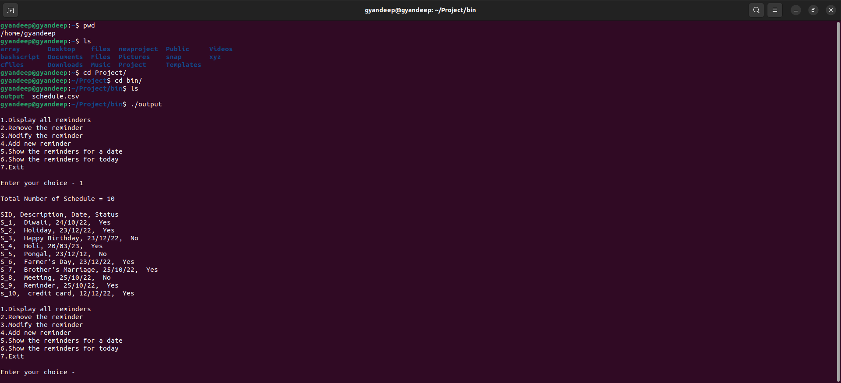
SCREENSHOTS

Slide 14
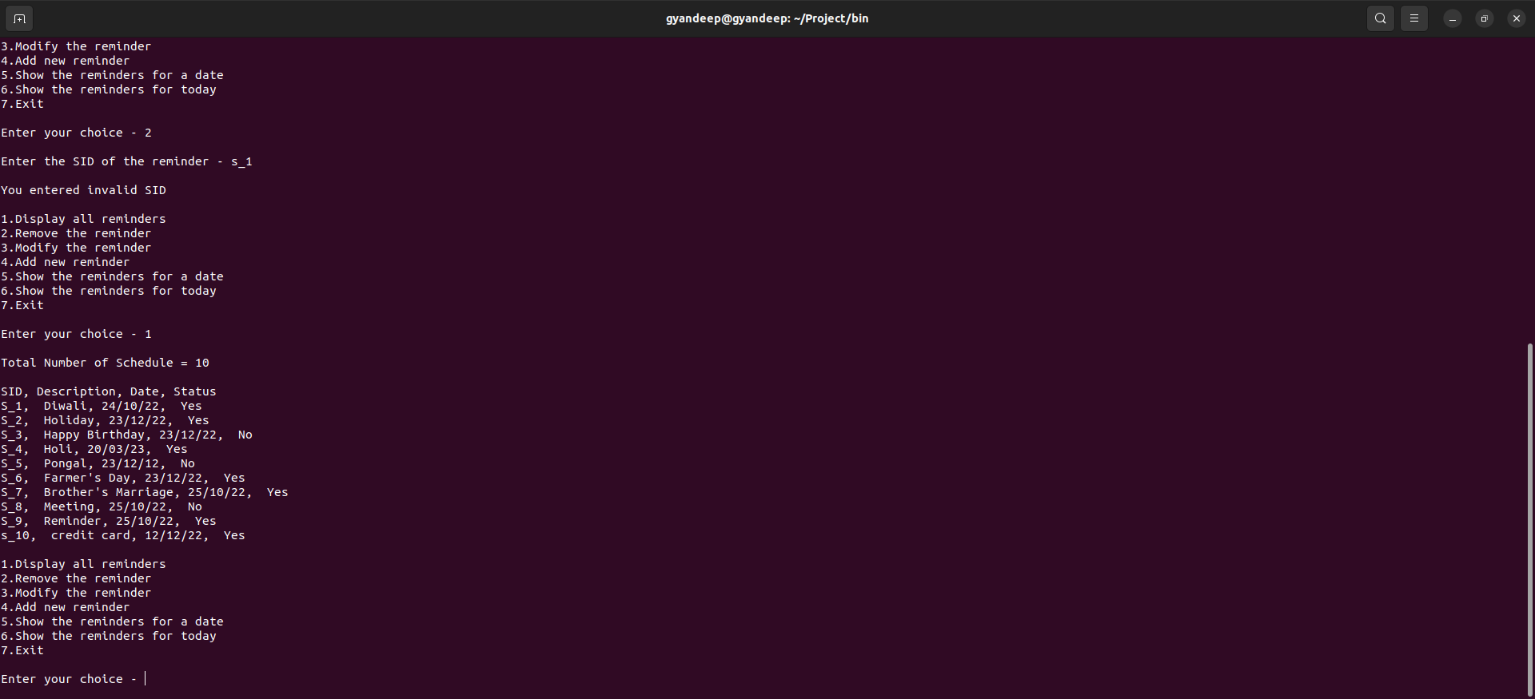
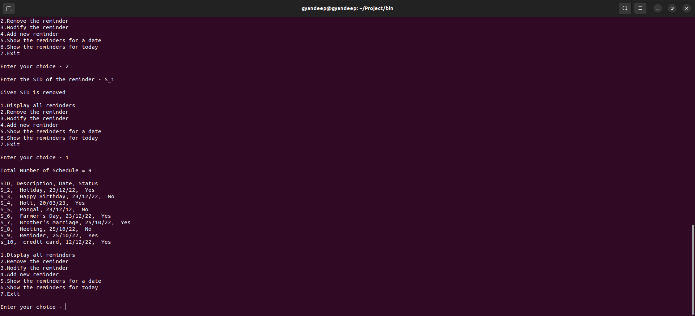
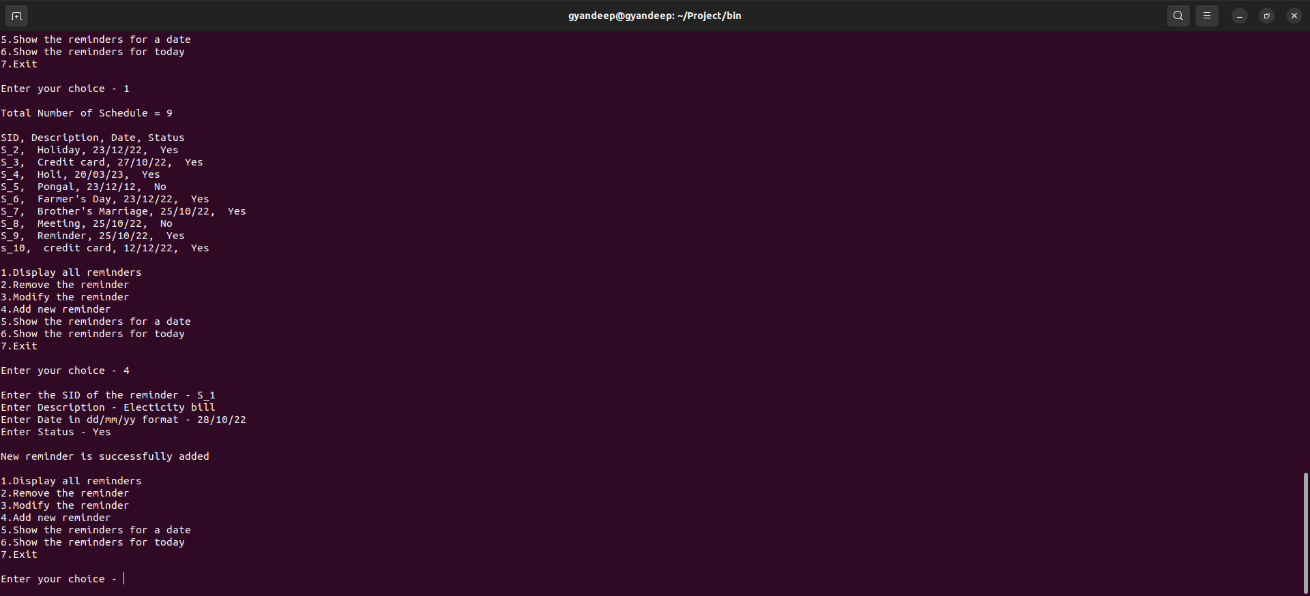
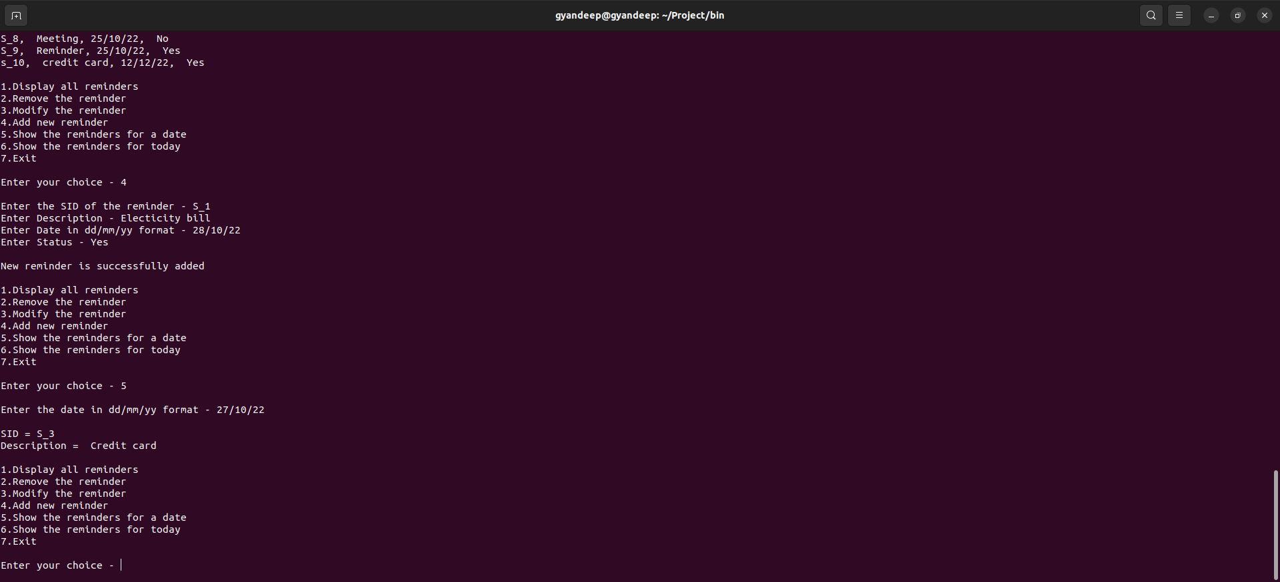

Slide 15
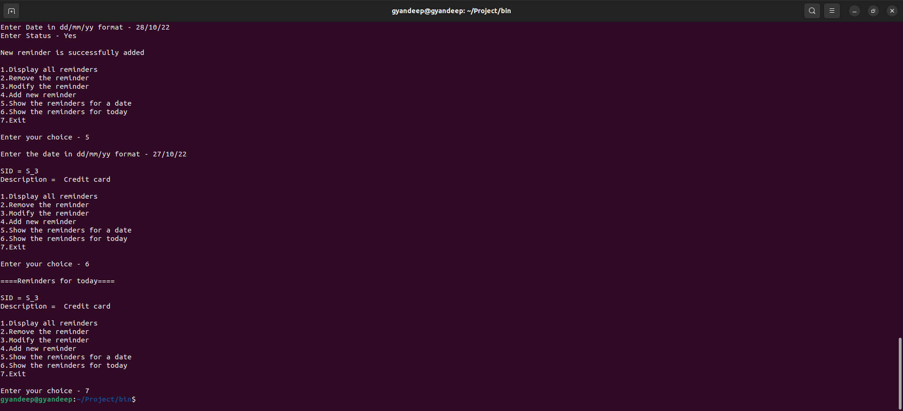

Slide 16
Summary
It provides a general architecture for reminder application, and individual can use it as the basis for getting reminder . The application is written in c language and used tools like valgrind splint , gdb. there are multiple options are there so that user can
add/remove/modify reminders and having options like enable or disable options.

Slide 17
Thank you
GROUP 8

